Slide 1


DropBlock:
A regularization method
for Convolutional Networks.
Ludovico Ottobre, 1712005
Gianmarco Evangelista, 1711818
La Sapienza, University of Rome

Slide 2

Background
Regularization is a technique used to reduce the errors by fitting the function appropriately on the given training set and avoid overfitting. It refers to a model that models the training data too well.
Dropblock, a form of structured Dropout, improves the performances of Dropout especially in deep architectures with skip connections where skip some layer in the neural network and feed the output of one layer as the input to the next layers where units in contiguous region are dropped together.
Neural Network, Sapienza Ludovico Ottobre, Gianmarco Evangelista.

Slide 3
Introduction
DropBlock method was introduced to combat the major drawback of Dropout being dropping features randomly which prove to be effective strategy for fully connected networks but less fruitful when it comes to convolutional layers wherein features are spatially correlated. DropBlock technique discards features in a contiguous correlated area called block. By doing so, it is able to fulfill the purpose of generating simpler model and to put in the concept of learning a fraction of the weights in the network in each training iteration to penalize the weight matrix which in turn reduces overfitting.
(a)
(b)
Mask sampling in DropBlock. (a) On every feature map, similar to dropout, we first sample a mask M. (b) Every zero entry on M is expanded to block_size X block_size zero block.
Neural Network, Sapienza Ludovico Ottobre, Gianmarco Evangelista.

Slide 4

DropBlock
The principal parameters for DropBlock algorithm are the size of the block to be dropped i.e. block_size and how many activation units to be dropped i.e. γ with each feature channel having its DropBlock mask.
$$γ= \frac{1−keep_prob}{{blocksize}^{2}}\frac{{featsize}^{2}}{{\left(featsize−blocksize+1 \right)}^{2}}$$
keep_prob is the threshold probability set wherein all the elements whose probability is less than keep_prob are effectively removed.
featsize is the size of feature map.
featsize - blocksize + 1 is the valid seed region.
Neural Network, Sapienza Ludovico Ottobre, Gianmarco Evangelista.

Slide 5
DropBlock
Input Feature Map
Mask Obtained
This mask is obtained by applying Bernoulli on gamma over the feature map.
Where gamma is obtained using the above formula keeping a fixed block_size and keep_prob.
A spatial square mask with height and width corresponding to the block_size is created with center being each 0 position in the mask obtained.
All the values in this mask are set to 0.
DropBlock algorithm discards features in correlated area and the contiguous region of the feature map is dropped together.
Applying the obtained mask over feature map
Neural Network, Sapienza Ludovico Ottobre, Gianmarco Evangelista.

Slide 6
Properties of DropBlock
In our implementation, we set a constant block_size for all feature maps; DropBlock resembles Dropout when block_size = 1 and resembles SpatialDropout when block_size covers the full feature map.
In practice, we do not explicitly set γ. As stated earlier, γ controls the number of features to drop. The binary mask will be sampled with the Bernoulli distribution with mean 1 − keep_prob.
Following the idea proposed by the paper, we implemented a callback function that allowed us to decrease the keep_prob value over time. We use a linear scheme to decrease the value in question by acertain amount for each epoch.
Neural Network, Sapienza Ludovico Ottobre, Gianmarco Evangelista.

Slide 7
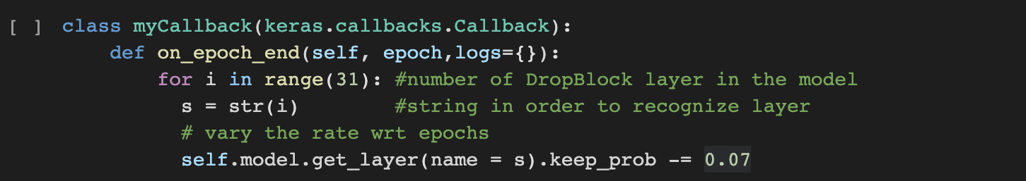
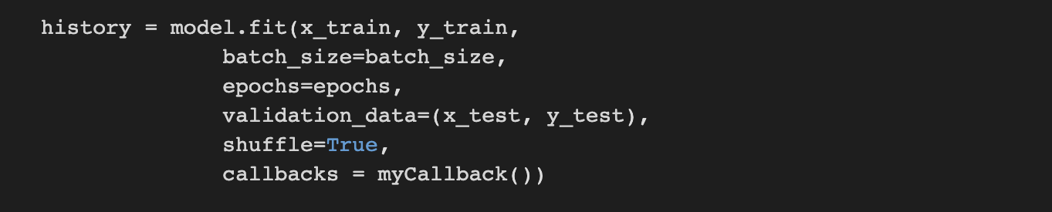
Scheduled DropBlock
Neural Network, Sapienza Ludovico Ottobre, Gianmarco Evangelista.

Slide 8
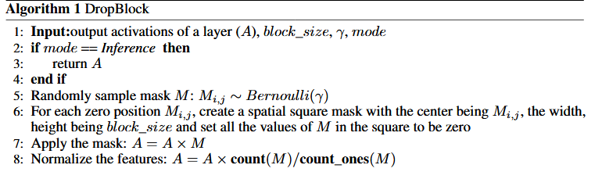
Pseudocode of DropBlock
Neural Network, Sapienza Ludovico Ottobre, Gianmarco Evangelista.

Slide 9
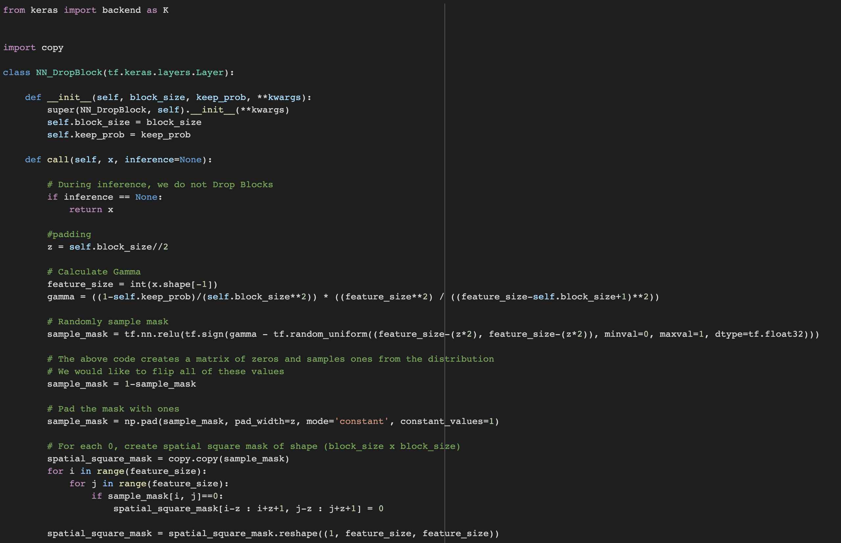
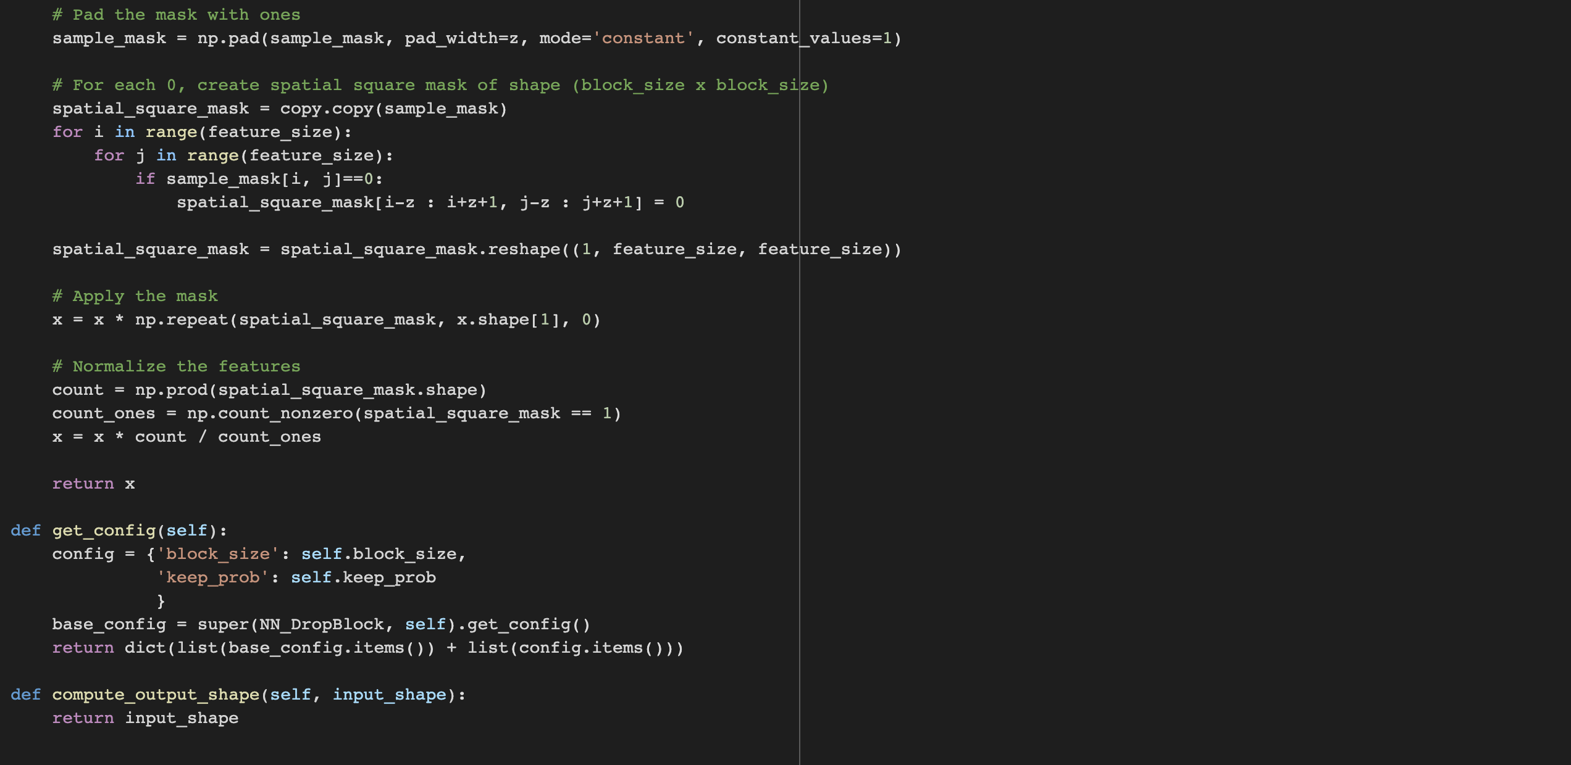
Implementation of DropBlock
Neural Network, Sapienza Ludovico Ottobre, Gianmarco Evangelista.

Slide 10
Datasets
Differently from original paper, in the project we developed we have used two of the most commonly used datasets, namely MNIST and CIFAR-10.
CIFAR-10
MNIST
Neural Network, Sapienza Ludovico Ottobre, Gianmarco Evangelista.

Slide 11
Datasets details
CIFAR-10 dataset is composed by 60,000 of 32x32 colour images from 10 classes, such as airplane, automobile, bird, cat, deer, dog, frog,horse, ship, truck. We have chosen to have 50,000 images for the training datasetand 10,000 for the test set.
The MNIST database of handwritten digits, has a training set of 60,000 examples, and a test set of 10,000 examples. It is a subset of a larger set available from NIST. The digits have been size-normalized and centered in a fixed-size image.
Neural Network, Sapienza Ludovico Ottobre, Gianmarco Evangelista.

Slide 12
Convolutional networks
In order to evaluate the correctness and functionality of DropBlock, we decided to use three different neural networks: custom CNN, DenseNet and ResNet. The networks were chosen to be able to analyze and compare the results obtained with those that were already available to us.
Each of the networks was processed in five different ways: default, with Dropout, with SpatialDropout, with DropBlock (block_size = 3) and with DropBlock (block_size = 7).
Since the DropBlock, as suggested by the paper under analysis, is useful and efficient especially for networks with skip connection, in addition to considering ResNet, we have chosen DenseNet for our analysis. In custom CNN, as we will see later, DropBlock does not guarantee improvements over Dropout.
Neural Network, Sapienza Ludovico Ottobre, Gianmarco Evangelista.

Slide 13
ResNet-50 Experiment
ResNet-50 is a CNN architecture widely used for image recognition. We have applied different regularization techniques on ResNet-50 in order to compare the result with DropBlock.
The configuration we chose to be able to insert DropBlock inside the model was to put the regularization method at the end of each Conv - Batch – Activation block, then immediately after the Relu activation function.
We have inserted DropBlock inside Identity and Conv blocks.
Neural Network, Sapienza Ludovico Ottobre, Gianmarco Evangelista.

Slide 14
Identity block implementation
Neural Network, Sapienza Ludovico Ottobre, Gianmarco Evangelista.

Slide 15
Convolutional block implementation
Neural Network, Sapienza Ludovico Ottobre, Gianmarco Evangelista.

Slide 16
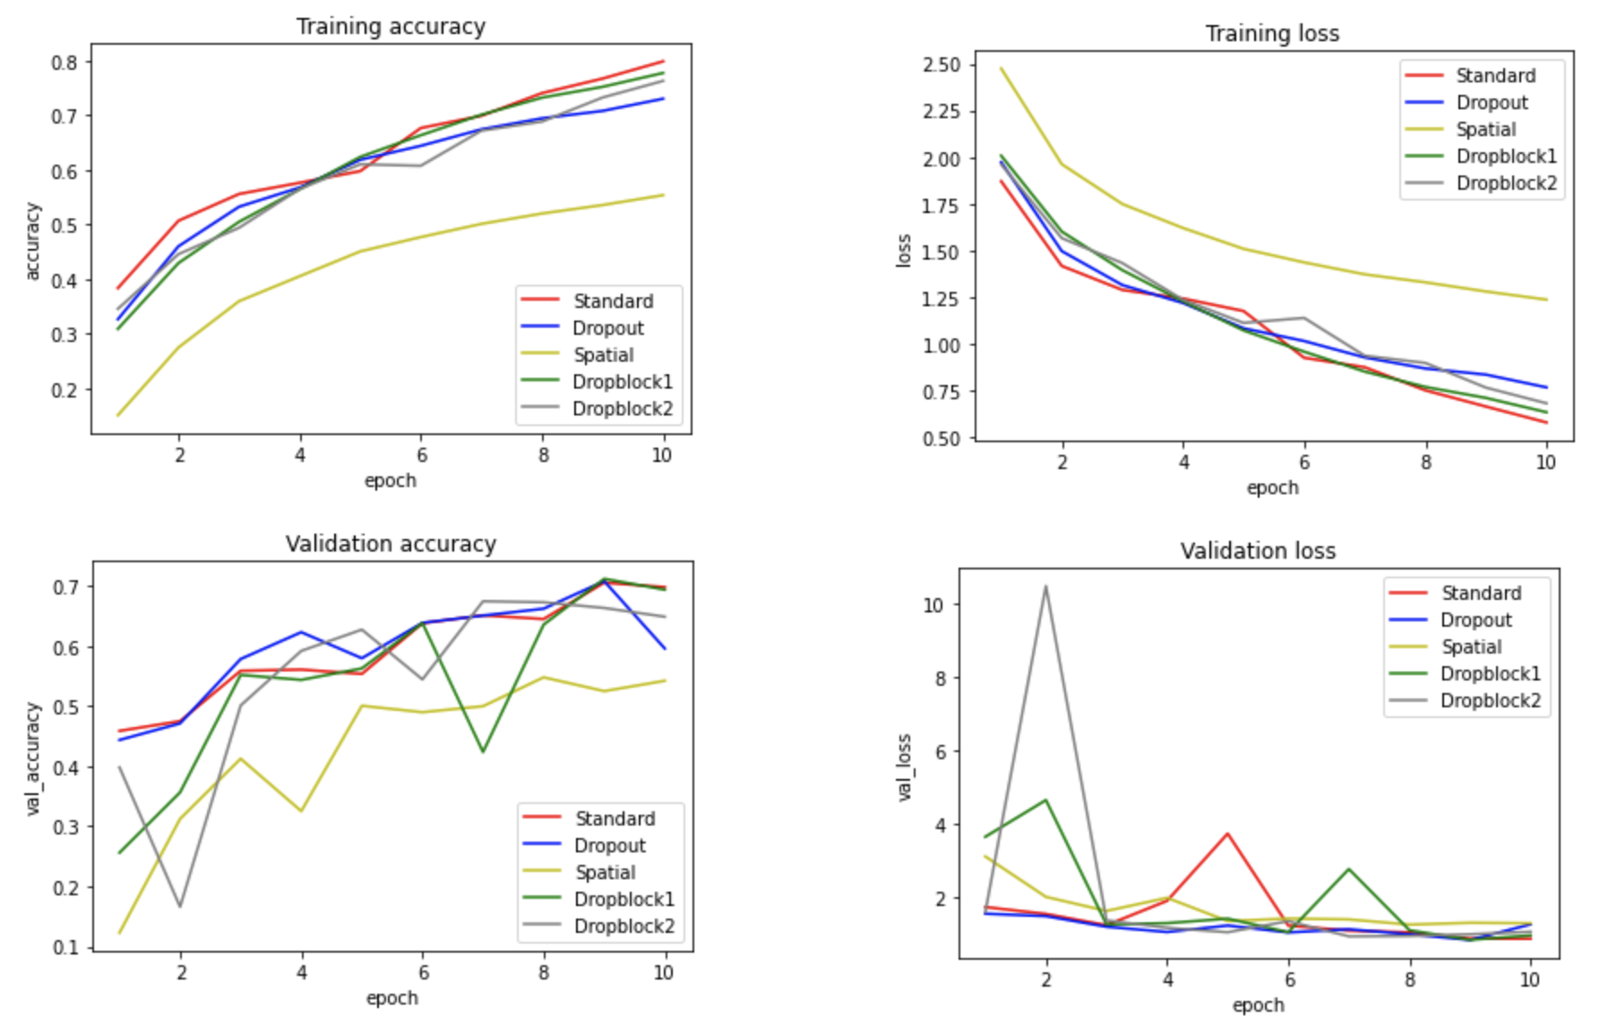
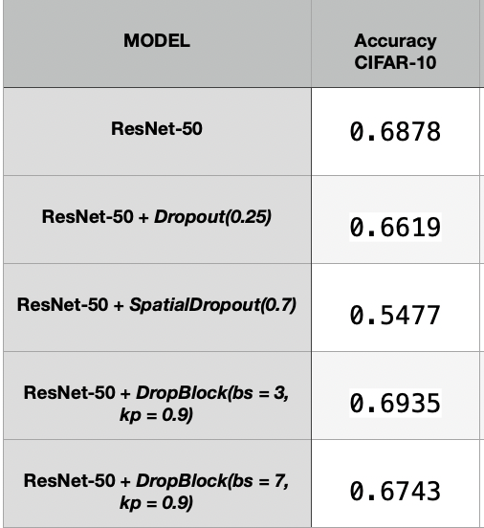
ResNet-50 Experiment
In the following table and graphs we can see the performances on CIFAR-10.
ResNet-50 accuarcy
ResNet-50 performances
Neural Network, Sapienza Ludovico Ottobre, Gianmarco Evangelista.

Slide 17
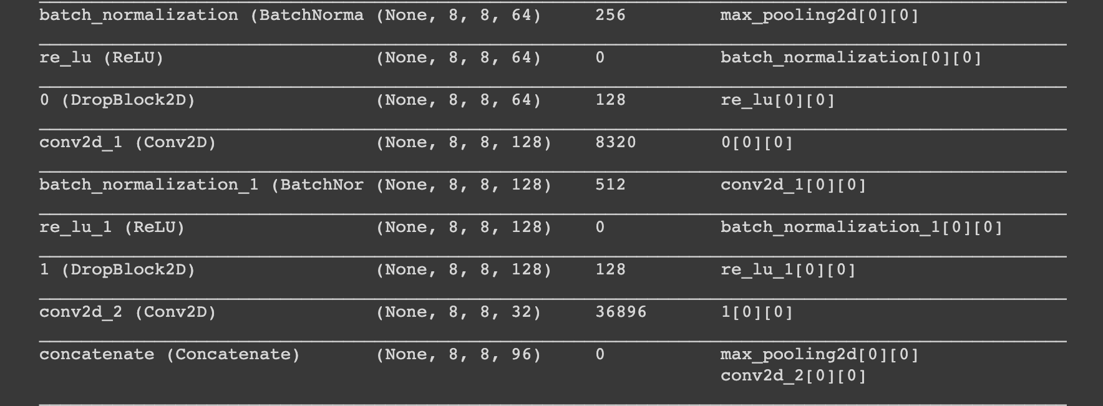
DenseNet Experiment
DenseNet is quite similar to ResNet with some fundamental differences. ResNet uses an additive method that merges the previous layer (identity) with the future layer, whereas DenseNet concatenates the output of the previous layer with the future layer.
It results to be, like ResNet, a model with skip connection. By using a skip connection, we provide an alternative path for the gradient (with backpropagation).
The configuration we have chosen to be able to insert DropBlock within DenseNet, follows the one that was the choice made in the case of ResNet. Again, we inserted DropBlock at the end of each Conv - Batch – Activation block, so right after the Relu activation function.
Neural Network, Sapienza Ludovico Ottobre, Gianmarco Evangelista.

Slide 18
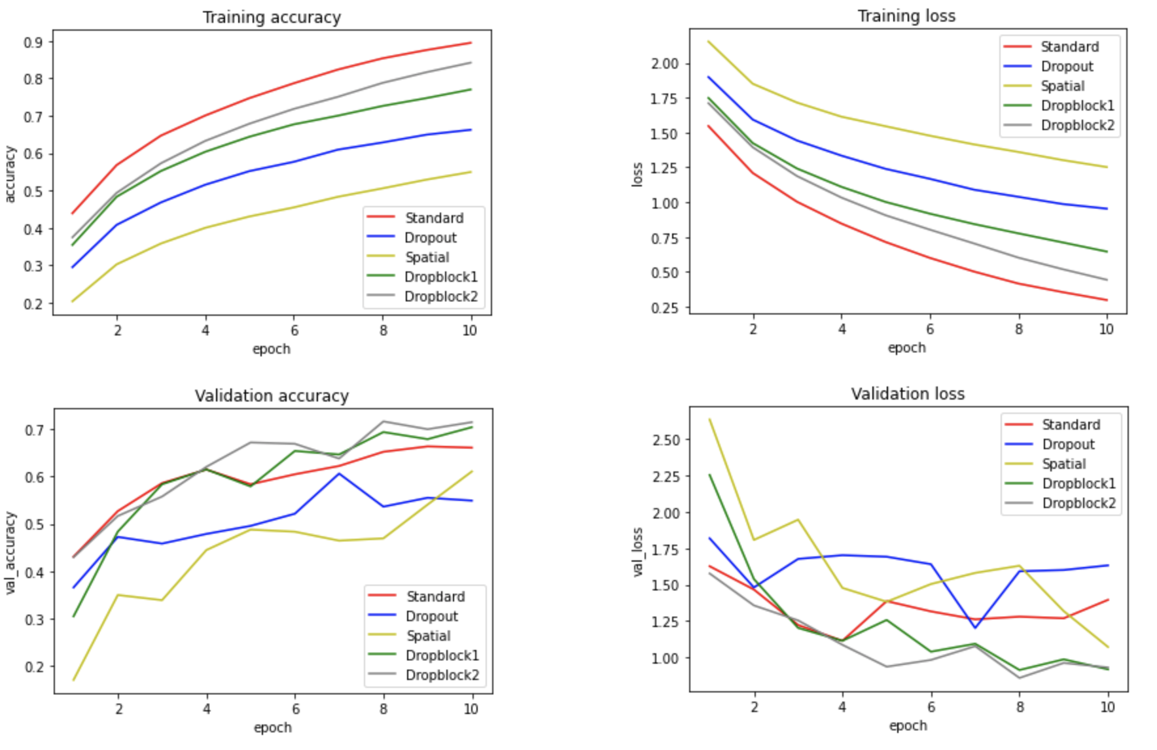
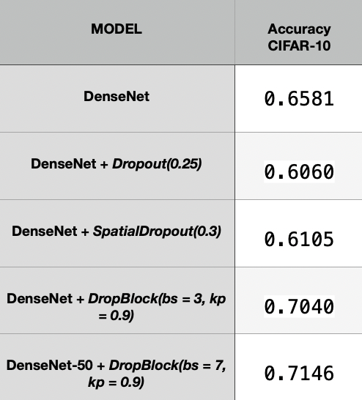
DenseNet Experiment
In the following table and graphs we can see the performances on CIFAR-10.
DenseNet accuracy
DenseNet performances
Neural Network, Sapienza Ludovico Ottobre, Gianmarco Evangelista.

Slide 19
CustomNet Experiment
This CNN has be done in order to evaluate DropBlock in a different architecture no skip connection. In this model we have a lower number of parameters compared to the architectures analyzed previously.
We have inserted Dropblock after MaxPooling2D since it was the best position in order to obtain the better result. In this model we have a number of epochs equal to 100 so we have a more gradual decrease of keep_prob.
Neural Network, Sapienza Ludovico Ottobre, Gianmarco Evangelista.

Slide 20
CustomNet
Neural Network, Sapienza Ludovico Ottobre, Gianmarco Evangelista.

Slide 21
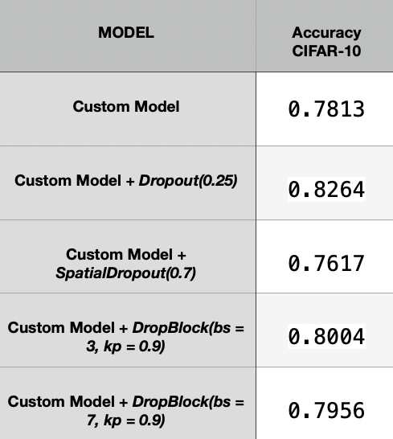
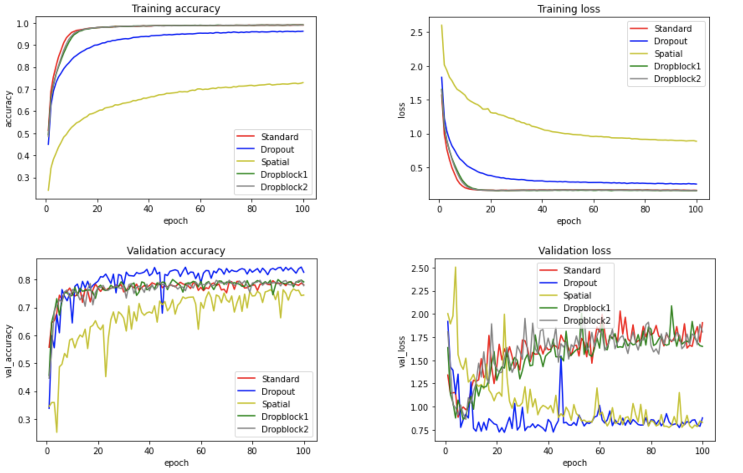
CustomNet Experiment
In the following table and graphs we can see the performances.
CustomNet accuracy
CustomNet performances
Neural Network, Sapienza Ludovico Ottobre, Gianmarco Evangelista.

Slide 22
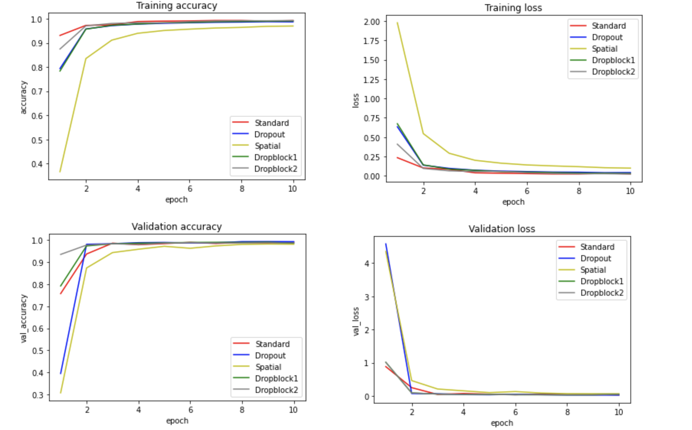
Results on MNIST
DenseNet
DenseNet performances
Neural Network, Sapienza Ludovico Ottobre, Gianmarco Evangelista.

Slide 23
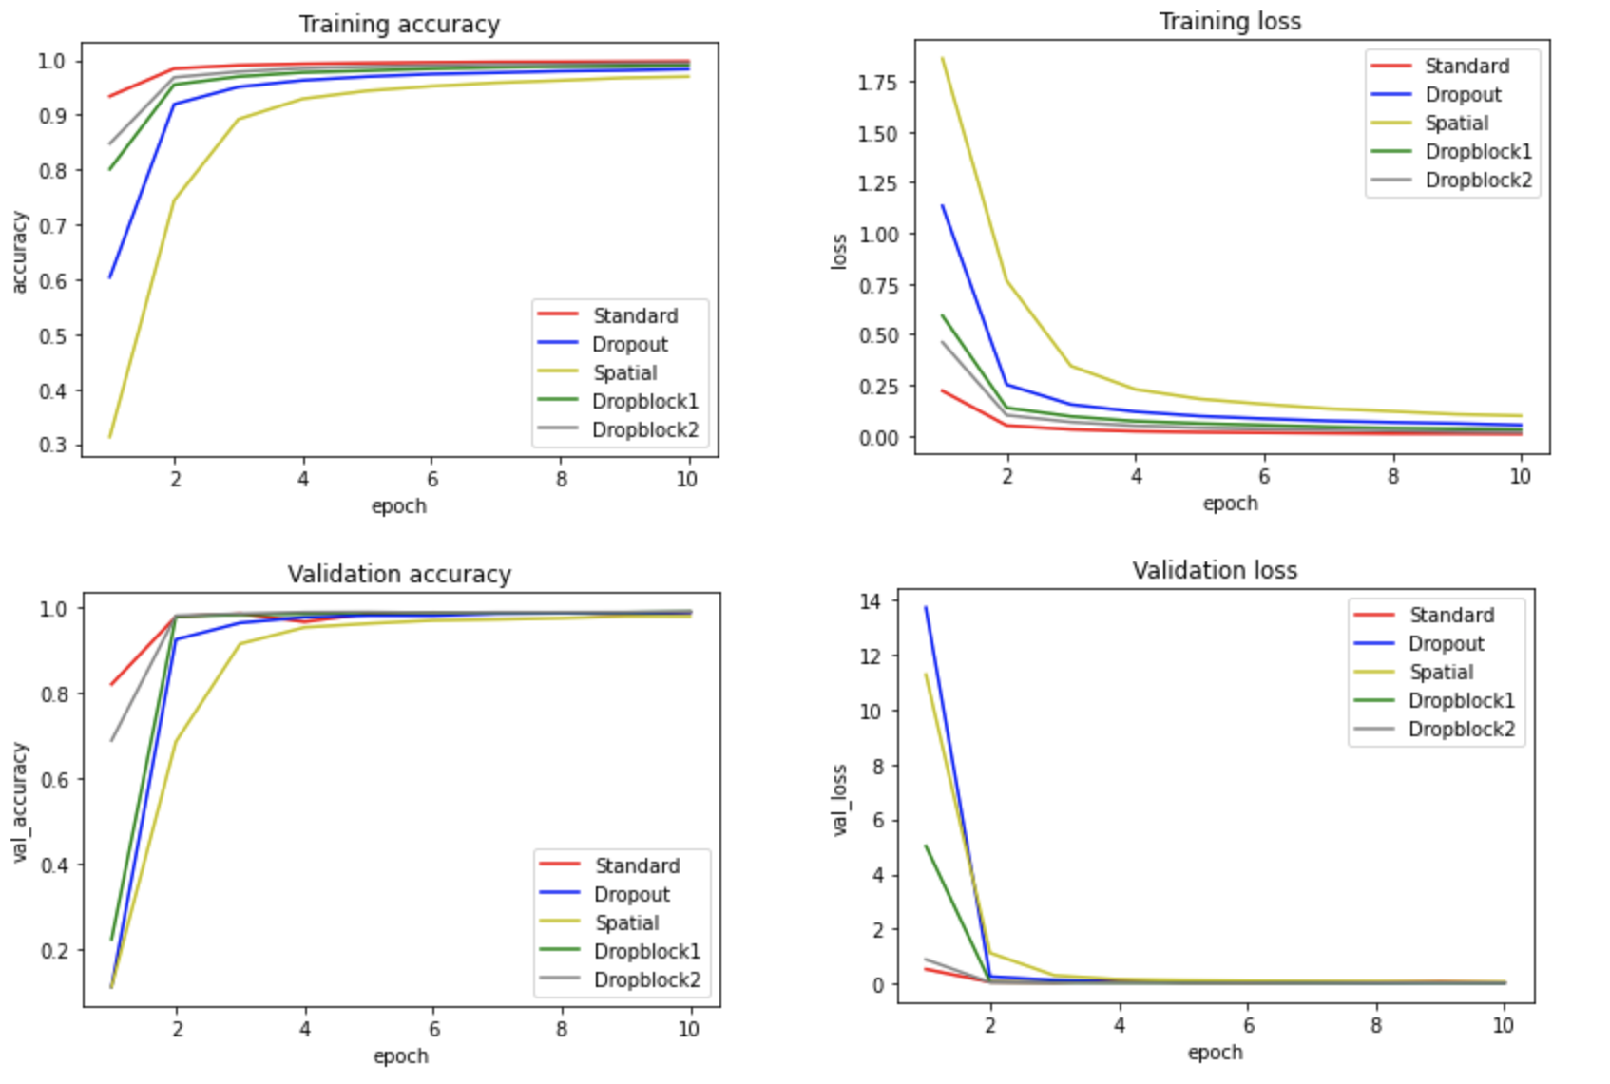
Results on MNIST
ResNet-50
ResNet-50 performances
Neural Network, Sapienza Ludovico Ottobre, Gianmarco Evangelista.

Slide 24
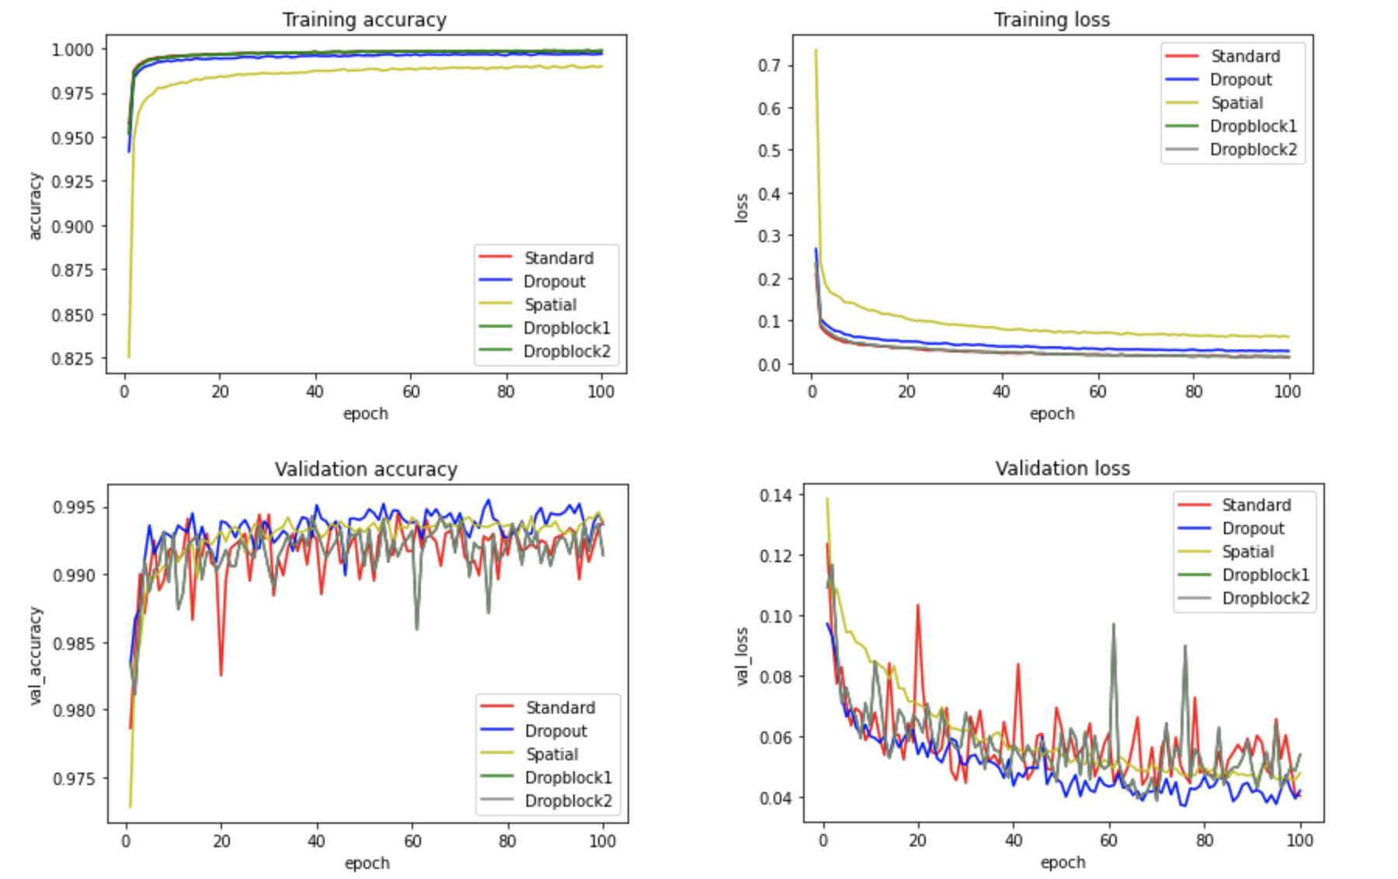
Results on MNIST
CustomNet
CustomNet performances
Neural Network, Sapienza Ludovico Ottobre, Gianmarco Evangelista.

Slide 25
RetinaNet on ResNet-50 Experiment
Object detection is a computer vision technique that allows us to identify and locate objects in an image or video. With this kind of identification and localization, object detection can be used to count objects in a scene and determine and track their precise locations, all while accurately labelling them.
In order to implement and evaluate DropBlock performance also in this computer vision technique, we have used RetinaNet based on ResNet-50 and we have inserted inside ResNet-50 FPN the DropBlock method.
Neural Network, Sapienza Ludovico Ottobre, Gianmarco Evangelista.

Slide 26
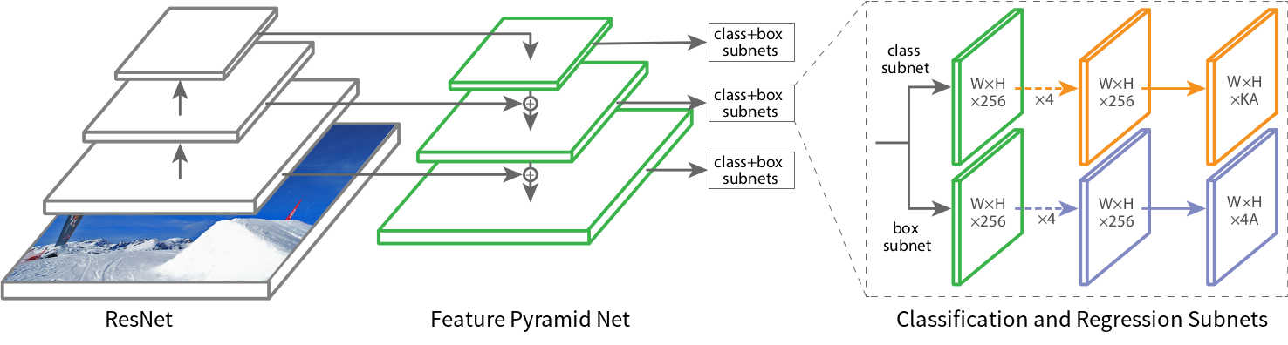
RetinaNet details
In this model, our goal is to localize and classify in the correct way all data into different categories. Object detection models can be broadly classified into "single-stage" and "two-stage" detectors. Two-stage detectors are often more accurate but at the cost of being slower. Here in this case, we have used RetinaNet, a single-stage detector, which is accurate and runs fast.
RetinaNet uses a feature pyramid network to efficiently detect objects at multiple scales and introduces a new loss, the Focal loss function, to alleviate the problem of the extreme foreground-background class imbalance.
Focal Loss gives to the model a bit more freedom to take some risk when making predictions. This is particularly important when dealing with highly imbalanced datasets beacuse in some cases, we really need to model to take a risk and predict something.
Neural Network, Sapienza Ludovico Ottobre, Gianmarco Evangelista.

Slide 27
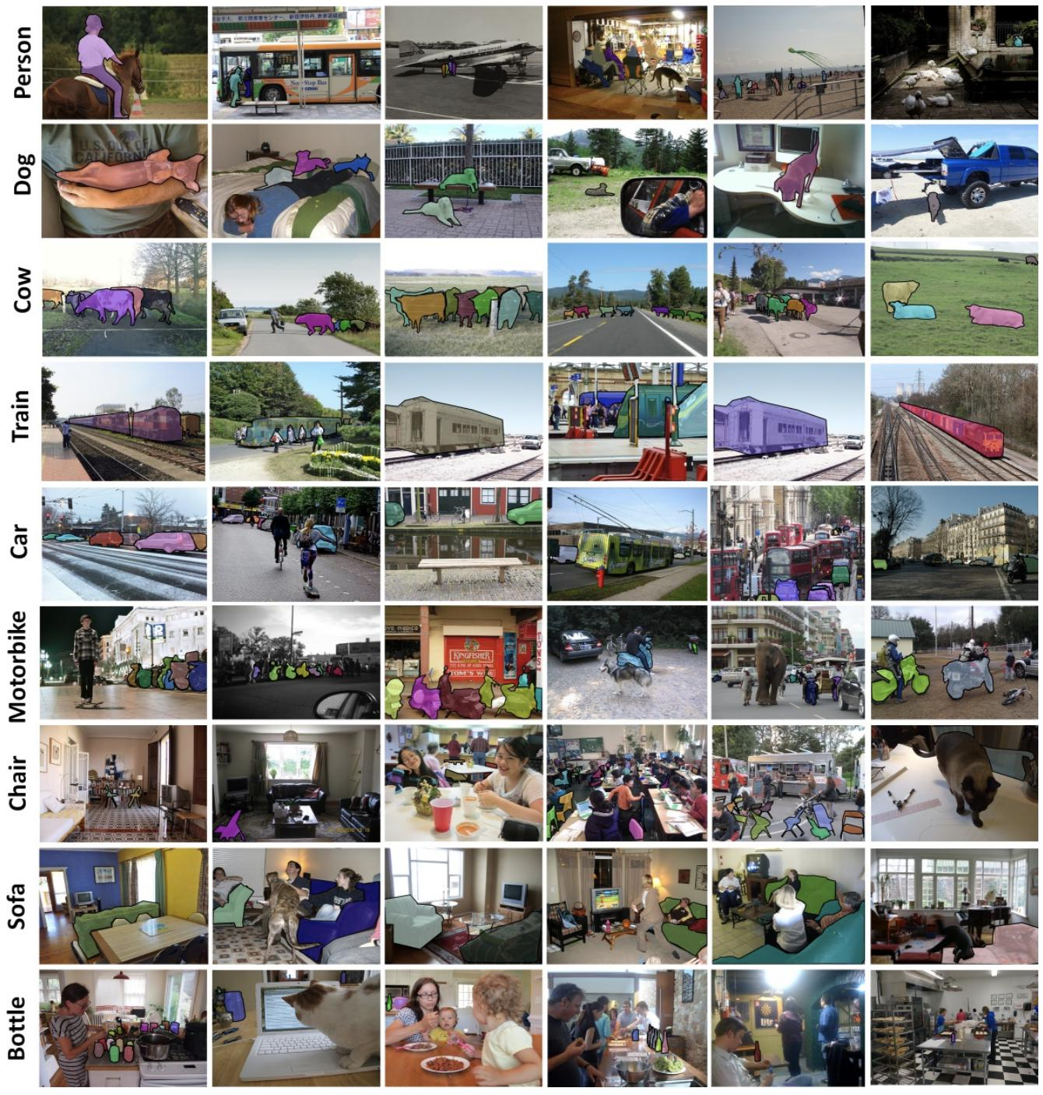
Object Detection Dataset
COCO is a large-scale object detection, segmentation, and captioning dataset. COCO has several features:
- Object segmentation
- Recognition in context
- Superpixel stuff segmentation
- 330K images (>200K labeled)
- 1.5 million object instances
- 80 object categories
- 91 stuff categories
- 5 captions per image
We have used a smaller subset of ~500 images for training in this case.
COCO-2017
Neural Network, Sapienza Ludovico Ottobre, Gianmarco Evangelista.

Slide 28
Object Detection with RetinaNet
Neural Network, Sapienza Ludovico Ottobre, Gianmarco Evangelista.

Slide 29
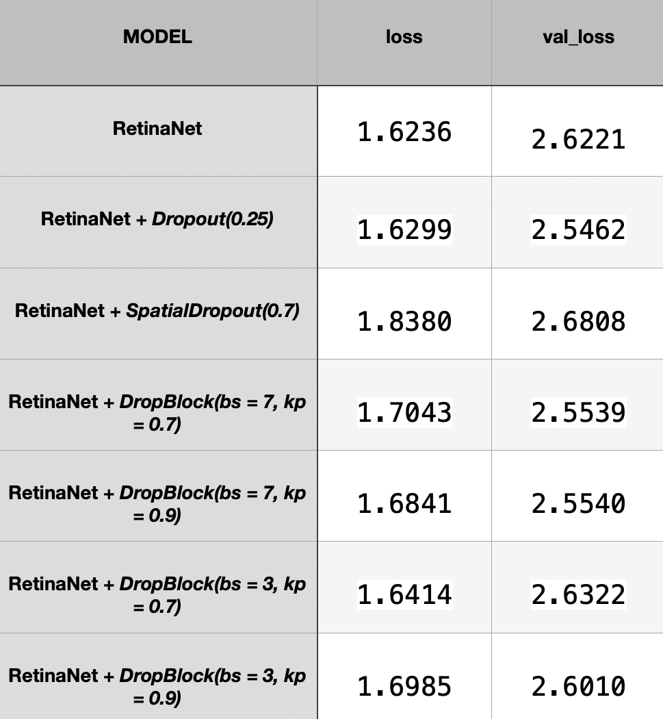
RetinaNet on ResNet-50 FPN Experiment
Analyzing the results based on loss and val_loss, we can say that lower is the loss, better is the model. The loss is calculated on training and validation and its interpretation is how well the model is doing for these two sets. Unlike accuracy, loss is not a percentage. It is a summation of the errors made for each example in training or validation sets. Loss value implies how well or poorly a certain model behaves after each iteration of optimization.
Ideally, one would expect the reduction of loss after each, or several, iteration(s). We considered the lowest loss value for each model and, making a theoretical evaluation of the results, we can see how DropBlock turns out to be a good alternative to other regularization methods such as Spatial and Dropout.
Neural Network, Sapienza Ludovico Ottobre, Gianmarco Evangelista.

Slide 30
Conclusions
The DropBlock technique been evidenced to effectively beat some of the best performance results obtained by traditional Dropout and Spatial Dropout as well as shows better performance corresponding to strong data augmentation techniques. DropBlock has proved to be effective regularization approach for object detection. Our experiments show that applying DropBlock in skip con- nections in addition to the convolution. It is a form of structured dropout that drops spatially correlated information.
We demonstrate DropBlock is a more effective regularizer compared to Dropout in CIFAR-10 and MNIST classification, in the same way results to be a good alternative for object detection in COCO dataset.
Neural Network, Sapienza Ludovico Ottobre, Gianmarco Evangelista.

